Slide 1
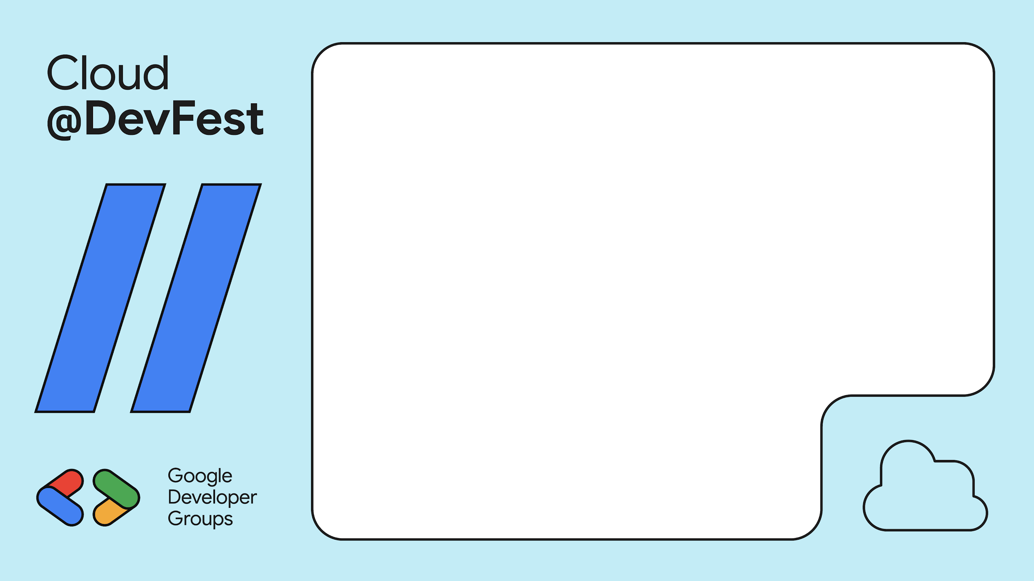
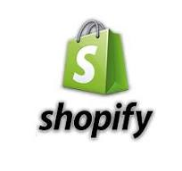
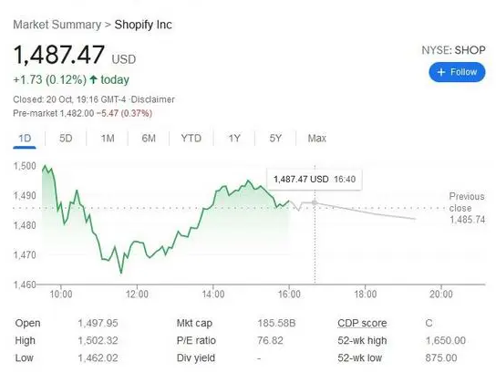
Did you know that Shopify uses Google Cloud Run to scale its e-commerce platform?
Notes:
Shopify leverages Cloud Run to manage spikes in traffic during major sales events, allowing the platform to scale seamlessly without compromising performance for millions of online store owners and shoppers worldwide.
This showcases Cloud Run's ability to handle dynamic workloads and provide scalability for high-demand services.

Slide 2
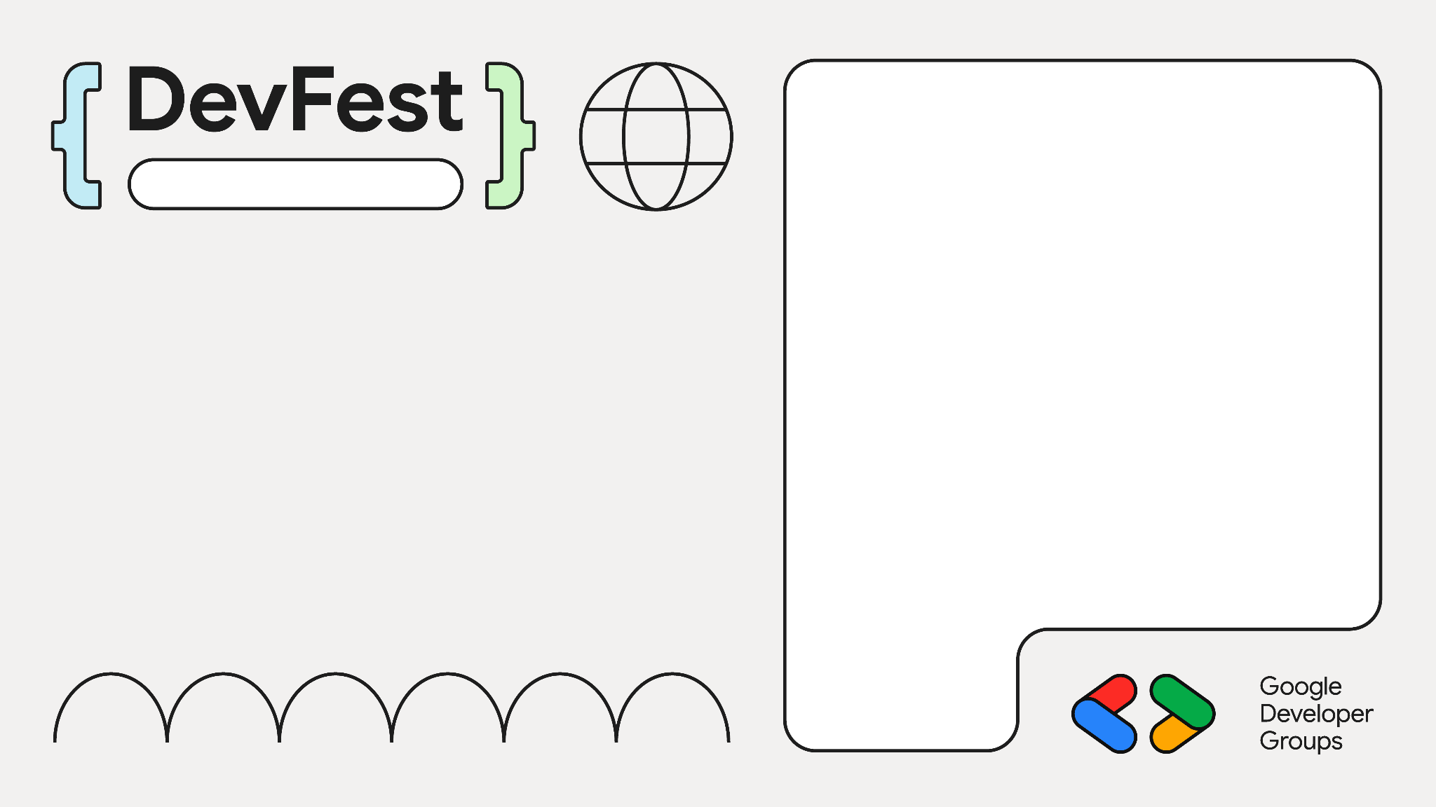



Cloud Engineer & Community Advocate
GCP Mentor - SSA 2024
Ex-GDSC - UEAB
A proud Man City Fan 💙
Rift Valley 2024
Samuel Macharia
Samuel Macharia
@engeniusam

Slide 3

On Your Mark, Get Set, Cloud Run:
A Sprint to Scalable Serverless Solutions
Rift Valley 2024
Saturday 23rd Nov, 2024

Slide 4
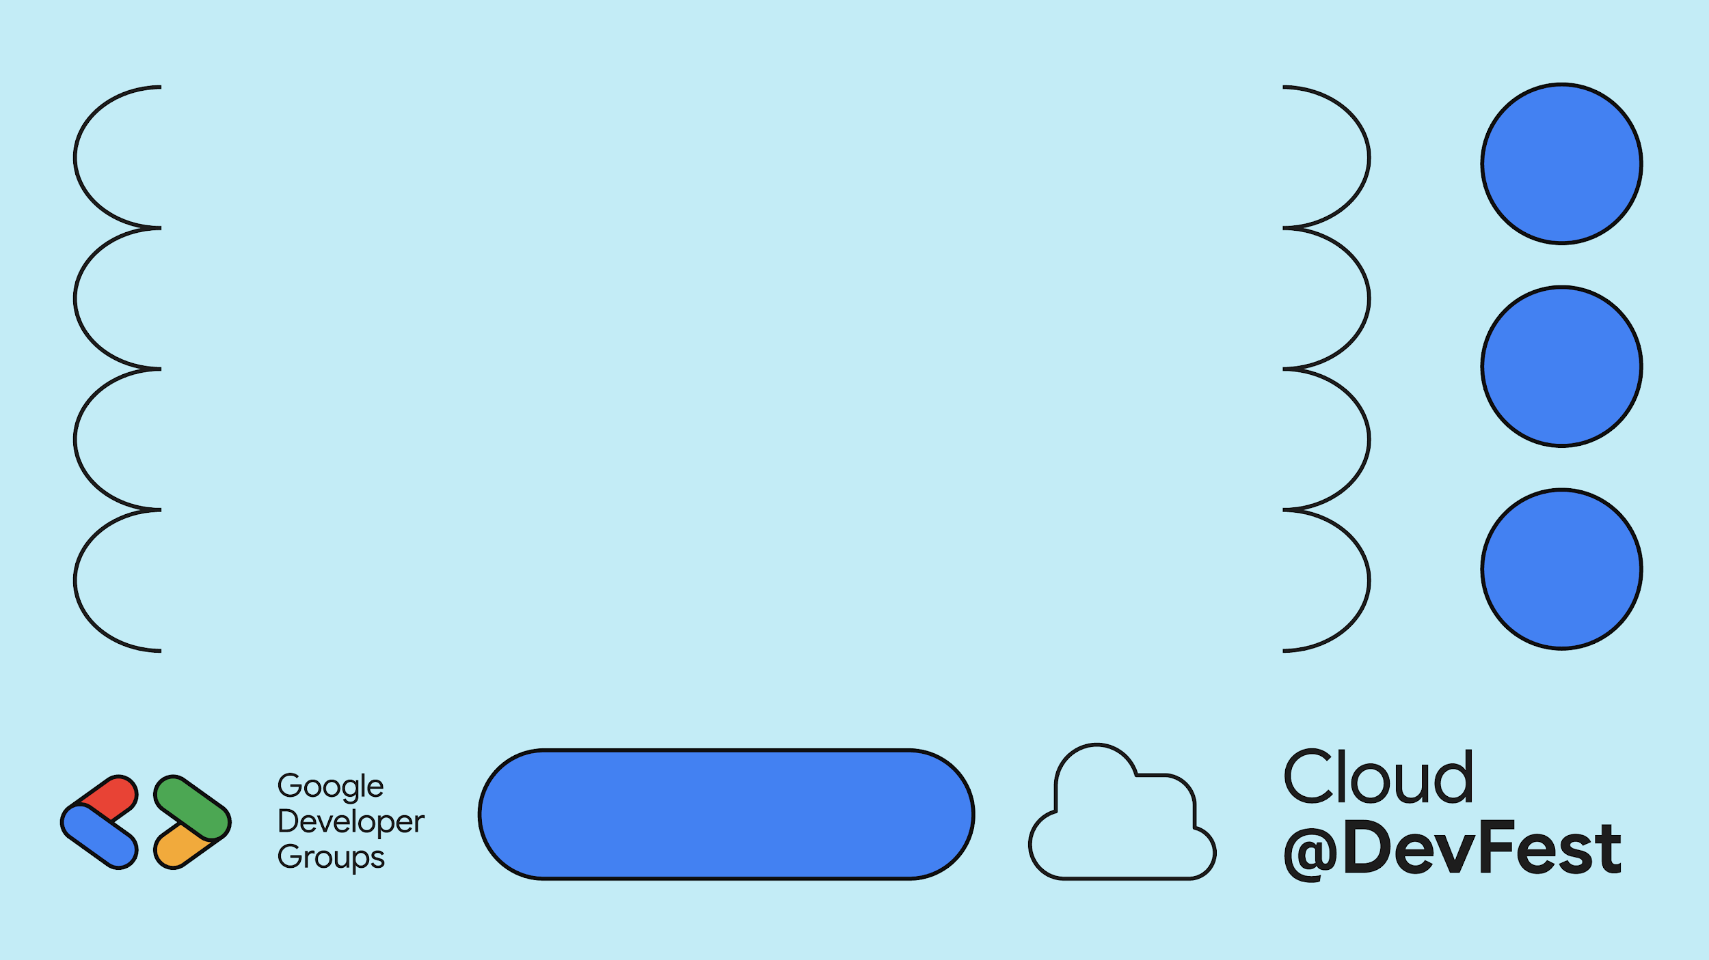
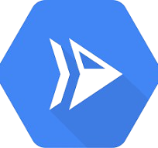
Introduction to Cloud Run
What is Cloud Run?
Serverless and fully managed
Runs containers on Google Cloud
Scales automatically based on traffic
Simplifies deployment and management
Pay only for what you use

Slide 5
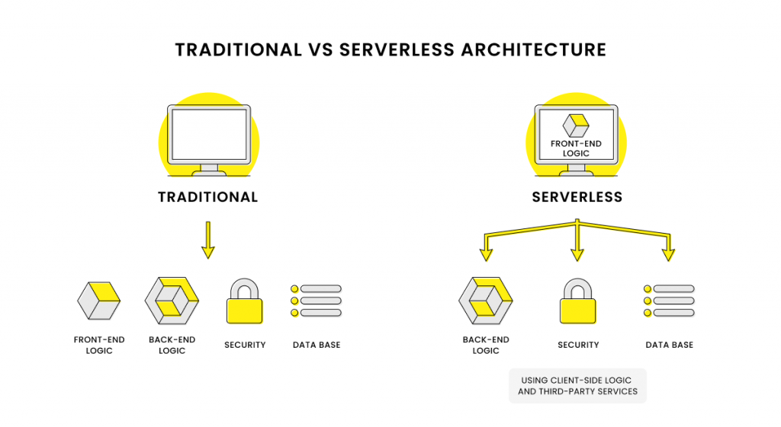
What is Serverless?

Slide 6
Rift Valley 2024
Why Serverless Matters
No server provisioning required
Automatic scaling based on demand
Pay-as-you-go pricing model
Reduces operational complexity
Focus on code, not infrastructure
Scales down to zero when idle

Slide 7
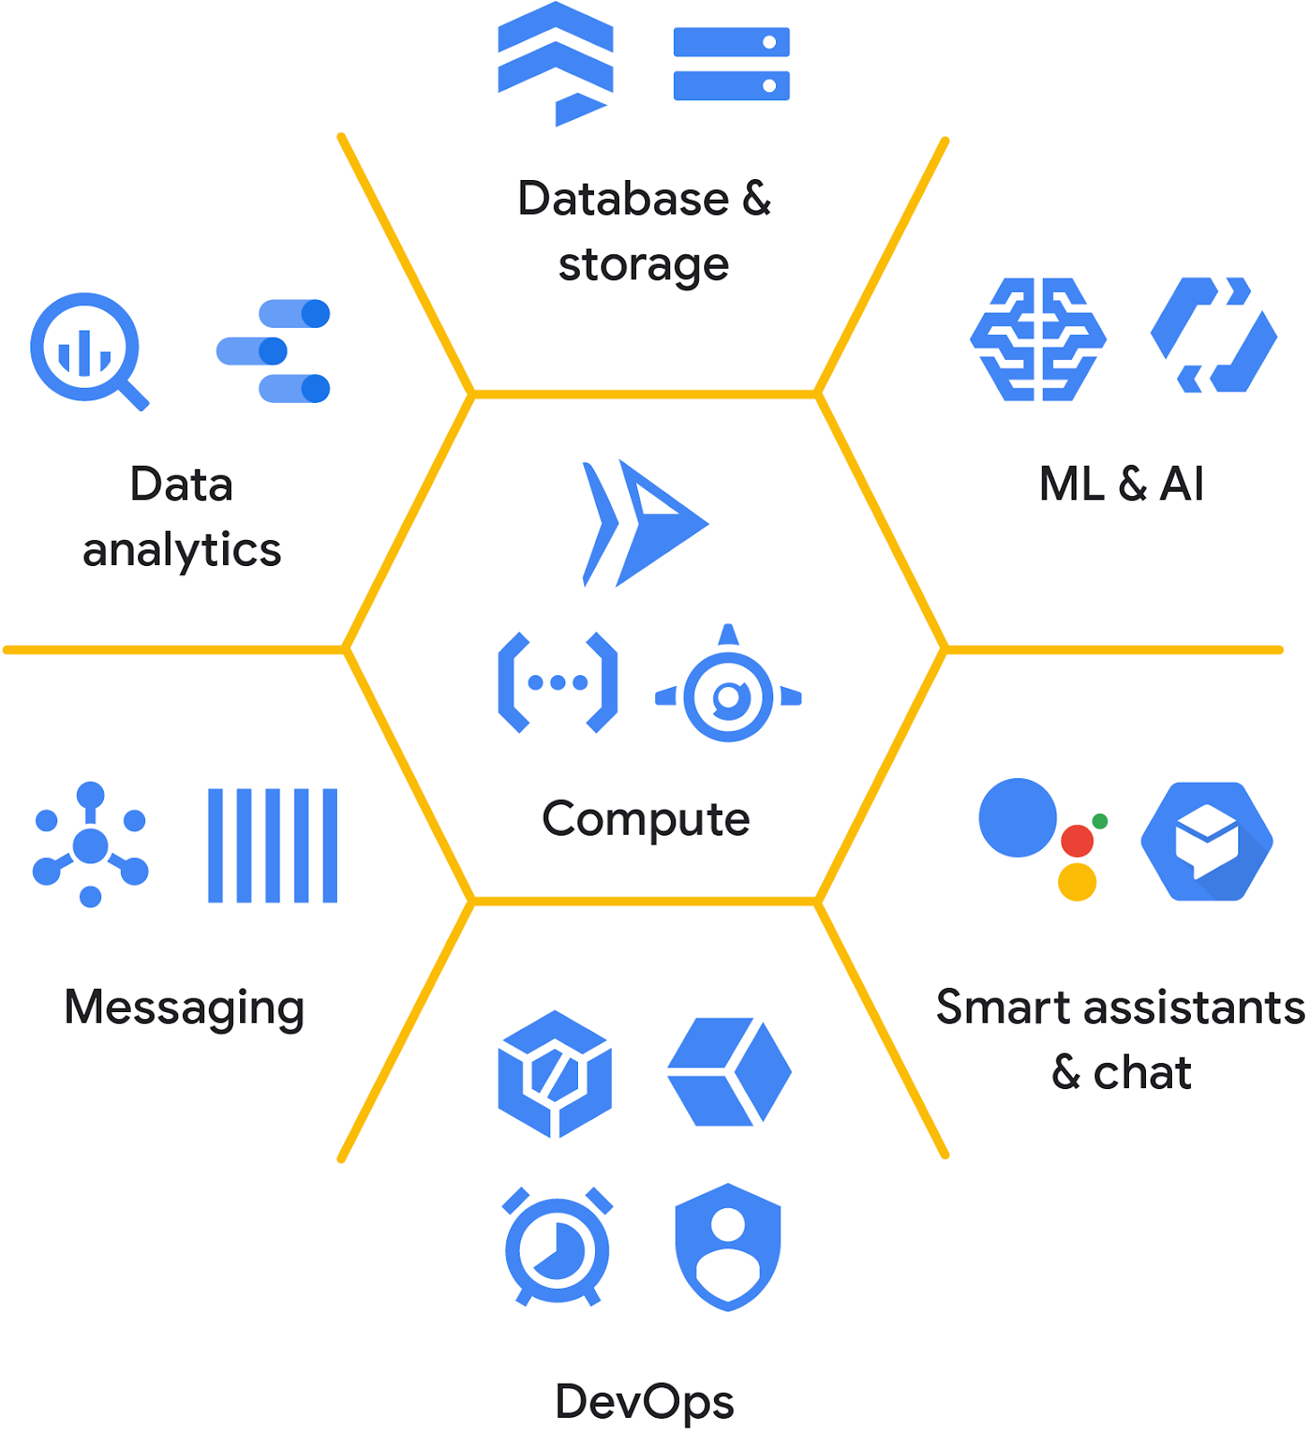





Key Benefits of Cloud Run
No infrastructure management
Auto-scaling from zero to thousands
Supports any language or framework
Handles HTTP(S) requests efficiently & Global scalability
Seamless integration with Google Cloud

Slide 8

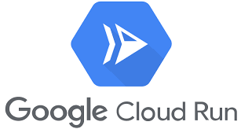
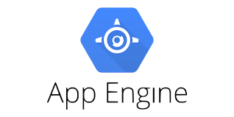
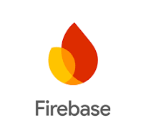
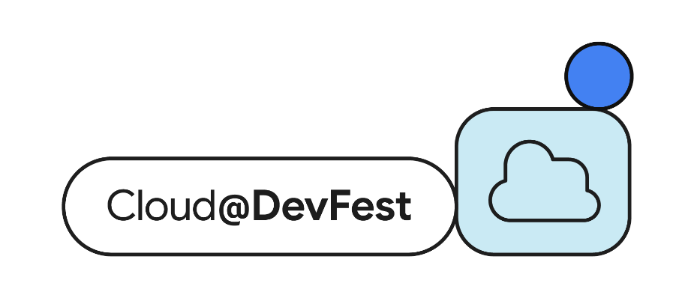
Why Cloud Run is Better Compared to Other GCP App Deployment Options
Fully Containerized
Automatic scaling
Cost Efficiency
Global Availability
Flexibility
Simplicity
Notes:
Fully Containerized: Supports any programming language or framework that can run in a container (unlike Firebase or App Engine).
Automatic Scaling: Scales from zero to thousands of instances automatically with no configuration required.
Cost Efficiency: Only pays for the resources used when the app is active (vs. fixed costs for App Engine).
Global Availability: Deploys globally without the need for managing infrastructure or regions manually.
Flexibility: Allows running both stateless and stateful services, with full control over runtime environments.
Simplicity: No need to manage servers or configurations like in App Engine, but with more control than Firebase.
Automatic Scaling:
Cloud Run: Scales from zero to thousands of instances automatically, handling dynamic traffic effortlessly without pre-configuration.
Firebase Hosting: Primarily for static content and requires additional configurations for scaling backend services (e.g., Cloud Functions).
App Engine: Scales well but has predefined scaling configurations and may incur cold starts or throttling with excessive traffic spikes.
Flexibility:
Cloud Run: Supports both stateless and stateful services, giving developers full control over runtime environments, including custom dependencies and containerization.
Firebase Hosting: Limited to static content or serverless functions; doesn't offer direct runtime control.
App Engine: Allows for custom runtime in Flexible Environment but lacks the full container-based flexibility of Cloud Run.

Slide 9
Deploying to Cloud Run
Containerize Your Application
Build and Tag the Docker Image
Push to Artifact Registry
Deploy to Cloud Run
Monitor Your App - Cloud Monitoring or Cloud Logging

Slide 10


Demo Time

Slide 11
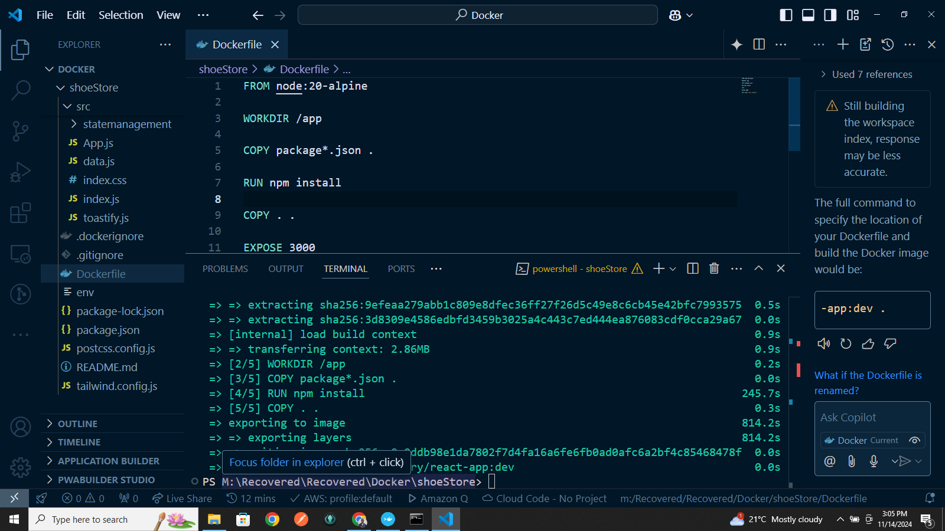
Containerize Your Application

Slide 12

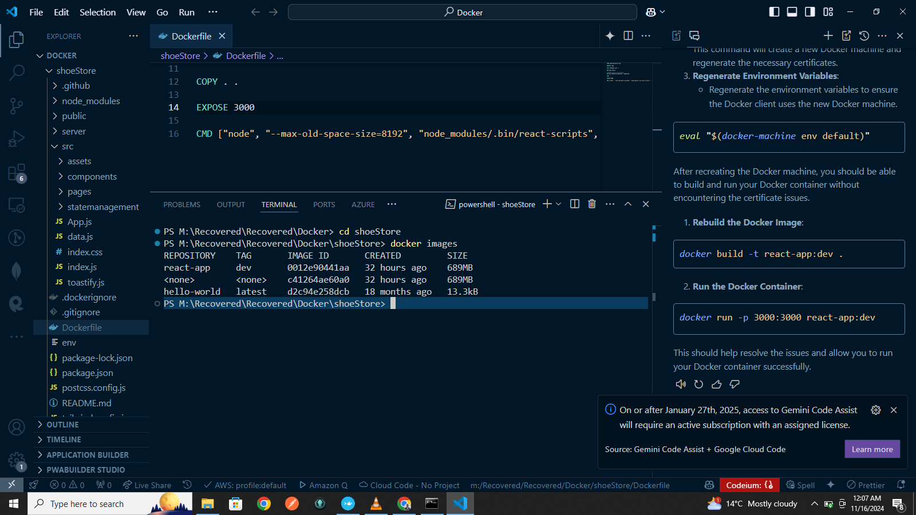
Build and Tag the Docker Image

Slide 13
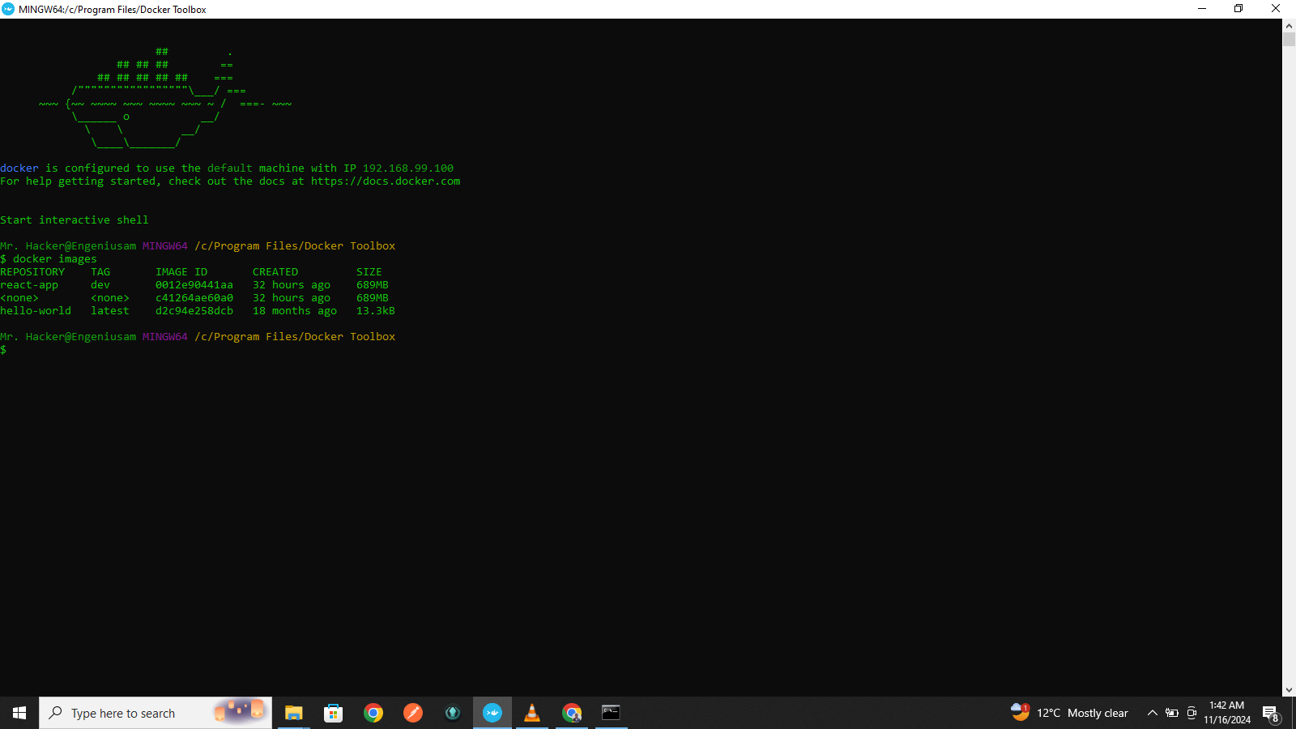
Confirm the Image on Docker ToolBox

Slide 14

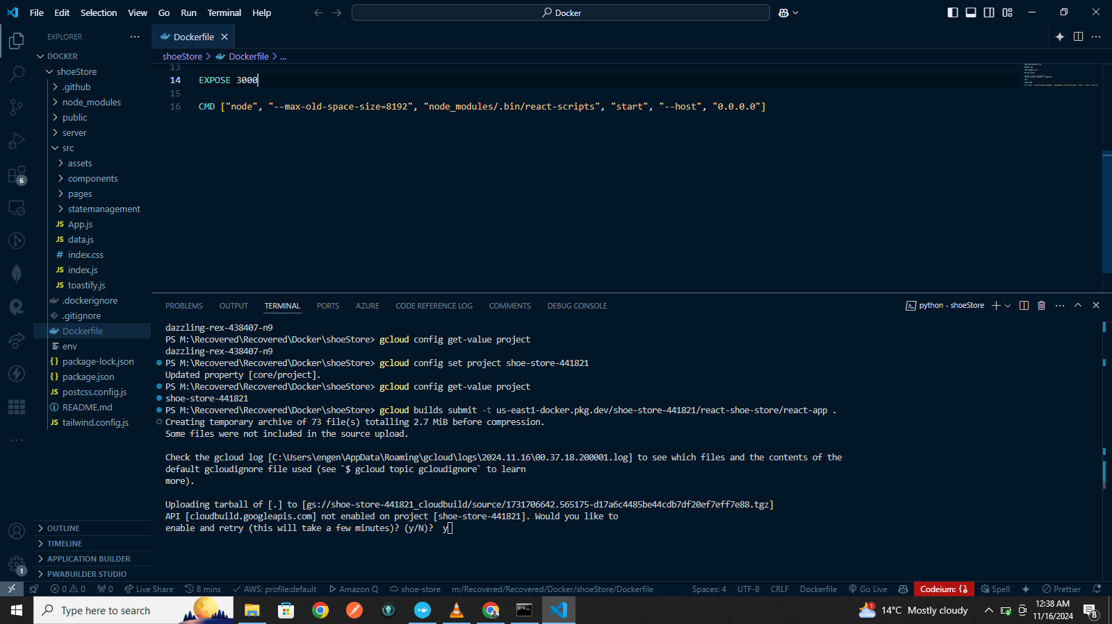
Confirm the Current Google Cloud Project

Slide 15

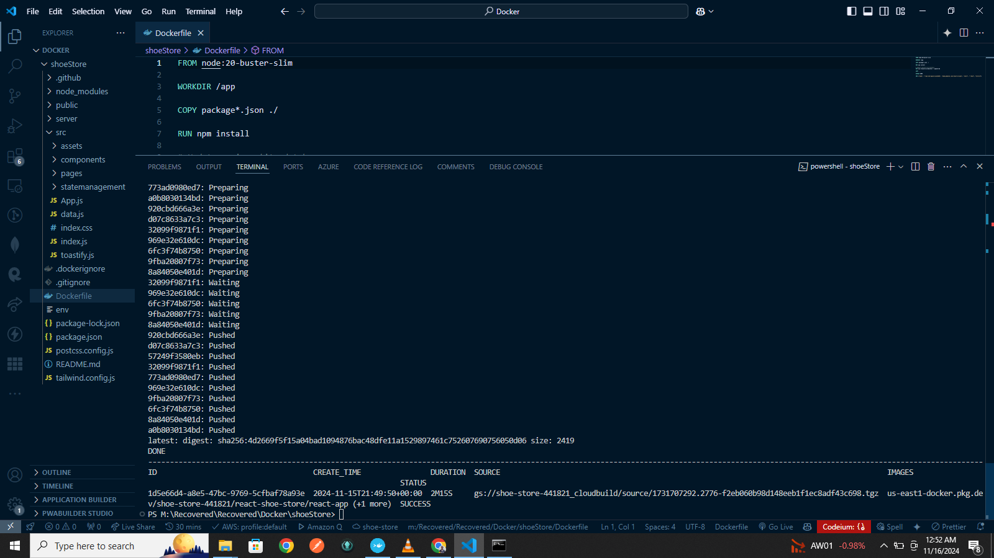
Push the Docker image to Artifact Registry

Slide 16
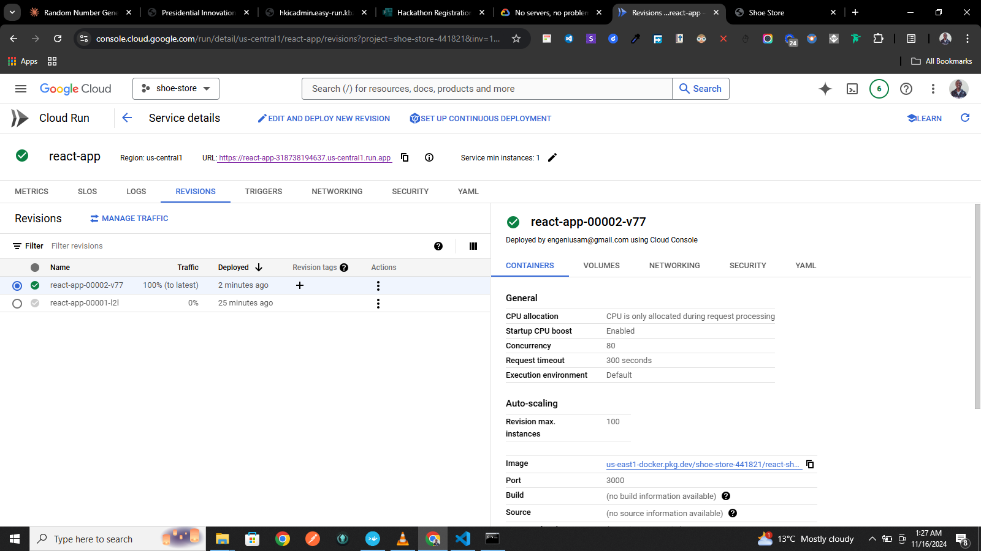
Deploy the app to Cloud Run

Slide 17
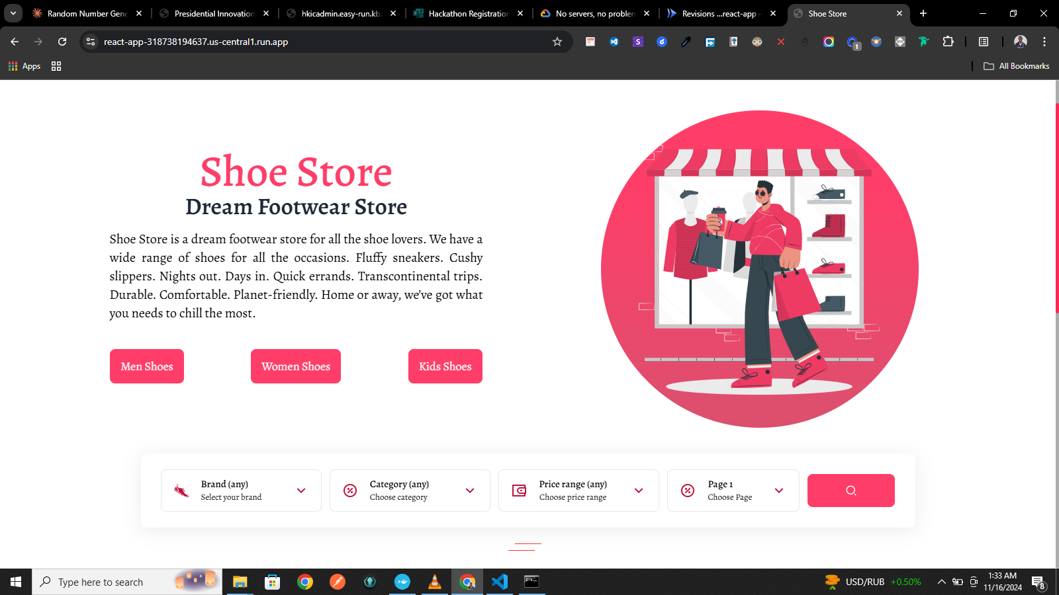
Boom!!!the app is Live: tinyurl.com/shoe-store-devfest-2024

Slide 18
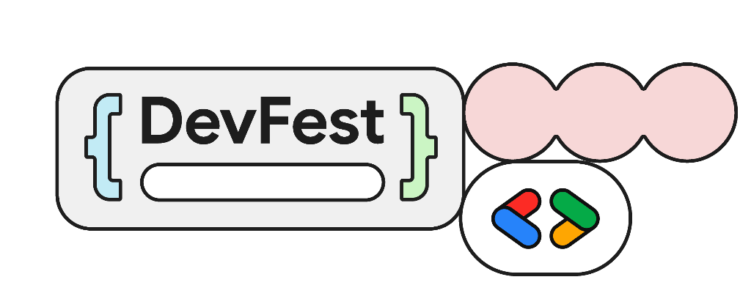


Rift Valley 2024
Scan me
Slides:tinyurl.com/devfest-rv-cloud-run-2024

